Slide 1
Testing Angular
Ori Calvo, 2017
oric@trainologic.com
https://trainologic.com

Slide 2
Types of Testing
Unit
Integration
System
Stress
Performance
Load
More …

Slide 3
Unit Testing
Unit as the smallest testable part of the application
Created by programmers
Run by programmers
Usually inside a class boundary
Does not cross process/network boundaries

Slide 4
F.I.R.S.T Principles
Fast
Isolated/Independent
Repeatable
Self Validating
Thorough and Timely

Slide 5
End to End Testing
The entire application is tested in a real world scenario
Testing whether a flow of the application is performing as designed from start to finish
Ensure the right information is passed between various system components and systems

Slide 6
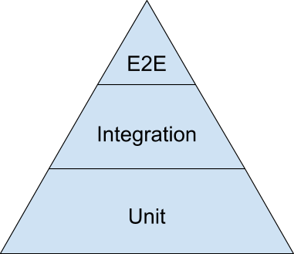
Testing Pyramid

Slide 7
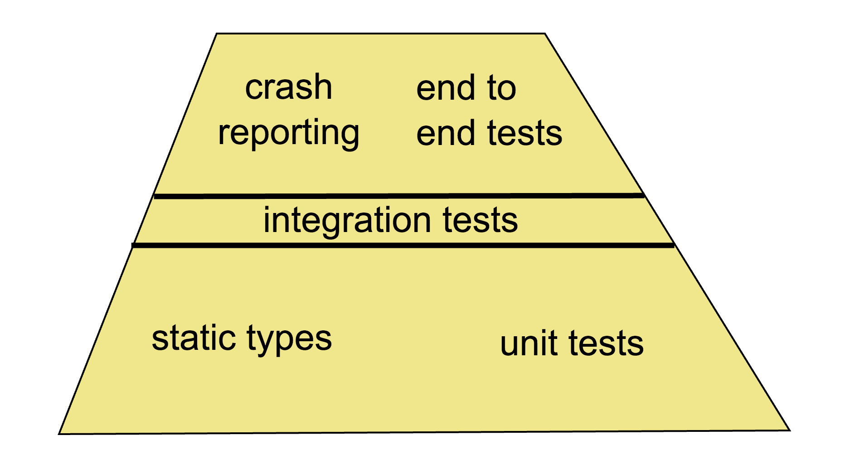
Testing Trapezoid

Slide 8
Technology Stack
Jasmine
Angular testing utilities
Karma
Protractor
WebDriver

Slide 9
Jasmine
Behavior driven development framework
For testing JavaScript code
No 3rd party library dependency
Does not require a DOM
Offers clean syntax for writing tests

Slide 10
Running under browser
npm install jasmine
Add reference to the following scripts/css
Add reference to your spec scripts
<script src="node_modules/jasmine-core/lib/jasmine-core/jasmine.js"></script> <script src="node_modules/jasmine-core/lib/jasmine-core/jasmine-html.js"></script> <script src="node_modules/jasmine-core/lib/jasmine-core/boot.js"></script>
<link rel="stylesheet" href="node_modules/jasmine-core/lib/jasmine-core/jasmine.css">

Slide 11
Running under NodeJS
node_modules/.bin/jasmine init
Creates spec/support/jasmine.json
Ensure spec_dir is correct
node_modules/.bin/jasmine
Executes all tests according to spec_files

Slide 12
My First Spec
class Contact { constructor(name) { if(!name) { throw new Error("Ooops"); } } }
describe("contact", function() { it("does not allow instantiation without name", function () { expect(() => { new Contact() }).toThrow(); }); });

Slide 13
Ingredients
Suite
Spec
Expectation
Matcher
Setup and Teardown
Spy

Slide 14
Suite
Begins with a describe function call
Has a name
Contains multiple specs (tests)
describe("CounterNewComponent", function () {
it("does not allow adding a counter without a name", function () {
...
});
});

Slide 15
Spec
Is defined using the it function
Takes a title and a function
Contains one or more expectation
A spec with all true expectations is considered a passing spec
describe("CounterNewComponent", function () {
it("does not allow adding a counter without a name", function () {
var comp = new CounterNewComponent();
comp.name = "";
comp.add();
expect(comp.errors.length).toBeGreaterThan(0);
});
});

Slide 16
Expectations
Are defined using the expect function
Takes an actual value and a matcher
Reports to Jasmine whether to pass or fail the spec
Negative matcher is achieved using the not function
No description ☹
describe("CounterNewComponent", function () {
it("does not allow adding a counter without a name", function () {
var comp = new CounterNewComponent();
comp.name = "";
comp.add();
expect(ctrl.errors.length).not.toBe(0);
});
});

Slide 17
Matchers
Jasmine offers the following matchers
Consider use Jasmine-Matchers library for more matchers
toBe | toBeGreaterThan | toBeNull
toBeDefined | toBeLessThan
toBeFalsy | toThrow | toBeUndefined
toBeTruthy | toEqual | toMatch(pattern)
toContain(member) | toContain(substring)

Slide 18
Custom Matcher
Use addMatchers inside it function
it("supports custom matcher", function () {
jasmine.addMatchers({
toBeEmptyString: function () {
return {
compare: function (actual, name) {
var pass = actual === "";
var message = (pass ? name + " is empty" : name + " is not empty");
return {
pass: pass,
message: message,
};
}
};
}
});
var name = "Ori";
expect(name).toBeEmptyString("name");
});

Slide 19
Setup and Teardown
A describe block may contain beforeEach and afterEach functions
Both are invoked before and after each spec (it)
The this keyword is the same for all three functions
describe("CounterNewCtrl", function () {
beforeEach(function () {
this.ctrl = {};
});
afterEach(function () {
this.ctrl = null;
});
it("this is the same", function () {
expect(this.ctrl).toBeDefined();
});
});

Slide 20
afterAll/beforeAll
Same as prveious slide
But this time the setup is executed before/after all specs
describe("contact", function() { beforeAll(function() { console.log("before"); }); afterAll(function() { console.log("after"); }); });

Slide 21
More
describe blocks can be nested
beforeEach and afterEach are called according to nesting tree structure
Appending “x” to a suite or spec disables it
xdescribe
xit
Appending “f” disable others
describe("CounterNewCtrl", function () {
beforeEach(function () {
});
describe("validation", function () {
beforeEach(function () {
});
it("nested spec", function () {
expect(this.ctrl).toBeDefined();
});
});
xit("disabled spec", function () {
expect(this.ctrl).toBeDefined();
});
});

Slide 22
Spy
Tracks calls to an object method
By default does not delegate the call
Use spyon.and.callThrough() to force delegation
it("calls CounterStore.add when validation pass", function () {
var store = new CounterStore();
var comp = new CounterNewComponent(store);
comp.name = "New Counter";
spyOn(store, "add").and.callThrough();
comp.add();
expect(store.add).toHaveBeenCalledWith("New Counter");
});

Slide 23
Spy API
and.returnValue
and.callFake
and.throwError
and.stub – Disables callThrough behavior
calls.any
calls.count
calls.all

Slide 24
createSpy & createSpyObj
In some cases there is no a function/object to spy on
Can create a bare spy
Or create a complete mock object
it("test", function () {
var spy = jasmine.createSpy("spy");
spy();
spy();
expect(spy.calls.count()).toEqual(2);
});
it("test", function () {
var obj = jasmine.createSpyObj("spy", ["func1", "func2"]);
obj.func1();
obj.func2();
expect(obj.func1).toHaveBeenCalled();
expect(obj.func2).toHaveBeenCalled();
});

Slide 25
jasmine.any
In some cases we don’t care about the parameter value being sent to a function but rather its type
Note: Jasmine compares constructors (not instanceof)
it("calls obj.func with a string", function () {
var obj = {
func: function (str) {
}
};
spyOn(obj, "func");
obj.func("abc");
expect(obj.func).toHaveBeenCalledWith(jasmine.any(String));
});

Slide 26
jasmine.objectContaining
By default toHaveBeenCalledWith verifies all object’s fields
Use jasmine.objectContaining to verify only part of the object
it("calls obj.func with an object that contains some fields", function () {
var obj = {
func: function (str) {
}
};
spyOn(obj, "func");
obj.func({
id: 1,
name: "Ori",
});
expect(obj.func).toHaveBeenCalledWith(jasmine.objectContaining({
id: 1
}));
});

Slide 27
How would you test the following ?
function InactivityMonitor() {
this.counter = 0;
this.handle = null;
this.events = [];
}
InactivityMonitor.prototype.start = function () {
const me = this;
const counter = me.counter;
this.handle = setInterval(function () {
if (me.counter == counter) {
me.events.push(new Date());
}
}, 60000);
}
InactivityMonitor.prototype.activity = function () {
++this.counter;
clearInterval(this.handle);
this.handle = null;
this.start();
}

Slide 28
jasmine.clock
Replaces the native setTimeout/setInterval functions with synchronous implementation
The registered callbacks are executed only if the clock is ticked forward in time
it("queues an event after inactivity of more than 1 minute", function () {
jasmine.clock().install();
var monitor = new InactivityMonitor();
monitor.start();
jasmine.clock().tick(60000);
expect(monitor.events.length).toBeGreaterThan(0);
});

Slide 29
jasmine-ajax
A library for faking AJAX response
Same pattern as the jasmine.clock
It replaces native XMLHttpRequest with synchronous implementation
Then, allows you to specify the response manually
See next slide for
jasmine.Ajax.install
jasmine.Ajax.requests

Slide 30
jasmine-ajax
it("fakes AJAX request", function () {
jasmine.Ajax.install();
$.ajax({
type: "GET",
url: "/api/counter",
success: function (counters) {
expect(counters.length).toBe(2);
},
error: function () {
expect(false).toBeTruthy();
}
});
request = jasmine.Ajax.requests.mostRecent();
request.response({
status: 200,
responseText: '[{"name": "Coffee", "value" :1}, {"name": "Sport", "value": 2}]',
});
// We get here only after success/error callbacks are executed
jasmine.Ajax.uninstall();
});

Slide 31
Promises
Even when using jasmine-ajax promise behaves in an asynchronous way
The spec might complete before the promise
Jasmine offers a done parameter which implies an asynchronous spec
You need to invoke done() when promise completes and all expectations where set

Slide 32
Promises
it("reports spec result only after promise completes", function (done) {
jasmine.Ajax.install();
var httpService = new MyApp.HttpService();
var counterStore = new MyApp.CounterStore(httpService);
counterStore.getAll()
.then(function (counters) {
expect(counters.length).toBe(0);
})
.catch(function (err) {
expect(false).toBeTruthy();
})
.finally(function () {
done();
});
request = jasmine.Ajax.requests.mostRecent();
request.response({
status: 200,
responseText: "[]",
});
// We get here before then/fail/fin complete
jasmine.Ajax.uninstall();
});

Slide 33
Testing Angular Entities
For each entity you may use different approach for testing
Services are usually easier to test
Components require HTML introspection
Pipes are stateless and therefore much easier to test

Slide 34
Isolated Testing
Examine an instance of a class all by itself
No Angular
No dependency injection
The tester use the new keyword
Supplying some test doubles for the ctor’s parameters
Probes the test instance API
Most suited for services & pipes

Slide 35
Testing a Service
export class ContactService { constructor(private httpClient: HttpClient) { } getAll(): Promise<Contact[]> { return this.httpClient.get<Contact[]>("assets/contacts.json").toPromise(); } }
it("should return all contacts when executing getAll", async done => { httpClientMock = { get: function () { return Observable.of([1, 2, 3]); } }; const service = new ContactService(httpClientMock); const contacts = await service.getAll(); expect(contacts.length).toBe(3); done(); });

Slide 36
Testing a Component
Isolated testing
Test component without rendering
Shallow testing
Render template without rendering children
Integration testing
Render the whole component sub tree

Slide 37
Component Shallow Testing
it('should render with a title', async done => { await TestBed.configureTestingModule({ declarations: [AppComponent], schemas: [NO_ERRORS_SCHEMA], }).compileComponents(); const fixture = TestBed.createComponent(AppComponent);
const h1 = fixture.nativeElement.querySelector("h1"); expect(h1).toBeTruthy(); expect(h1.textContent).toBe("My App"); done(); });

Slide 38
Component Integration Testing
<app-clock [format]=“clockFormat"></app-clock>
it(‘should push format into clock', async done => { await TestBed.configureTestingModule({ declarations: [AppComponent, ClockComponent], }).compileComponents(); const fixture = TestBed.createComponent(AppComponent); const app = fixture.componentInstance; const clock = fixture.debugElement.query(x => x.name == "app-clock").componentInstance; app.clockFormat = "HH"; fixture.detectChanges(); expect(clock.format).toBe("HH"); done(); });

Slide 39
Component with Async Service
it('should load all contacts on initialization', async done => { await TestBed.configureTestingModule({ declarations: [AppComponent], schemas: [NO_ERRORS_SCHEMA], providers: [ContactService], }).compileComponents(); const contacts = [{id:1, name: "Ori"}]; const service = TestBed.get(ContactService); const spy = spyOn(service, 'getAll') .and.returnValue(Promise.resolve(contacts)); const fixture = TestBed.createComponent(AppComponent); const comp = fixture.componentInstance; fixture.detectChanges(); // let ngOnInit run await spy.calls.mostRecent().returnValue; expect(comp.contacts).toBe(contacts); done(); });
export class AppComponent { contacts: Contact[]; constructor(private contactService: ContactService) { } async ngOnInit() { this.contacts = await this.contactService.getAll(); } }

Slide 40
async
Angular utility
Allows for easier syntax by using Zones
Monitor all asynchronous activities and notify jasmine on completeness
beforeEach(async(() => { TestBed.configureTestingModule({ declarations: [ BannerComponent ], }) .compileComponents(); // compile template and css }));

Slide 41
Page Object
A common pattern amongst testers
Wraps HTML inside a class
Allowing you to manipulate page element without digging into HTML
class Page { saveBtn: DebugElement; cancelBtn: DebugElement; constructor(fixture) { const buttons = fixture.debugElement.queryAll(By.css('button')); this.saveBtn = buttons[0]; this.cancelBtn = buttons[1]; } save() { this.saveBtn.triggerEventHandler("click"); } }

Slide 42
End to End Testing
Selenium RC
Selenium 2 & WebDriver API
selenium-webdriver binding to NodeJS
Protractor

Slide 43
Selenium Remote Control (RC)
The original selenium solution for automating tests
Injects some JavaScript into the page
The injected code interacts with Selenium Server
The test app interact with the same Selenium Server
Thus, the test app can communicate with the web page

Slide 44
Web Driver Protocol
W3C standard (recommendation phase)
A remote control interface for controlling user agents
A platform and language neutral wire protocol
Allows for discovering and manipulation of DOM elements
Primary intent is to support automated tests
https://www.w3.org/TR/webdriver/

Slide 45
Supported Browsers
Chrome
IE 7+
Firefox
Safari
Opera
PhantomJS
Android
iOS

Slide 46
selenium-webdriver
A NodeJS binding to WebDriver API
Must install a driver for each type of browser and put it inside PATH
chromdriver.exe
IEDriverServer.exe
Others …
Then just use plain JavaScript inside NodeJS application

Slide 47
Using selenium-webdriver
const {Builder, By, Key, until} = require('selenium-webdriver'); let driver = new Builder() .forBrowser('chrome') .withCapabilities({ browserName: "chrome", chromeOptions: { args: ['disable-infobars'] } }) .build(); driver.get('http://www.google.com'); driver.findElement(By.name('q')).sendKeys('webdriver', Key.RETURN); driver.wait(until.titleContains('webdriver'), 1000); driver.quit();

Slide 48
Selenium Server
Most browser drivers do not accept remote connections
Selenium server acts as a proxy between our test app and browser’s driver
Thus, allowing the browser to execute on a remote machine
No need to use it for local execution
A Java based application

Slide 49
Running with Selenium Server
java -jar selenium-server-standalone-2.45.0.jar
var driver = new webdriver.Builder() .forBrowser('firefox') .usingServer('http://localhost:4444/wd/hub') .build();

Slide 50
Common API
findElement
By.name
By.css
getText
click
submit
switchTo().window(‘windowName’)
navigate().forward

Slide 51
Control Flow
WebDriver uses a special promise manager that schedule all promises in a serial fashion
You write cleaner code
No need to handle then and catch
Might be surprising during debugging
Can be disabled using SELENIUM_PROMISE_MANAGER

Slide 52
Protractor
An abstraction on top of WebDriver
Offers simpler API
Offers some tools
Webdriver-manager
Has integration with Angular
Mostly Angular 1

Slide 53
Getting Started
Everything is already setup by angular/cli
You may ensure browser drivers are up to date using webdriver-manager update
npm run e2e
Launches WebDriver instance
Executes all specs under e2e folder

Slide 54
Protractor API
browser
element
by
ExpectedConditions

Slide 55
Page Object (again …)
export class AppPage { buttonInc: ElementFinder; counter: ElementFinder; constructor() { this.buttonInc = element(by.css("app-root button.inc")); this.counter = element(by.css("app-root span.counter")); } navigateTo() { return browser.get('/'); } inc() { this.buttonInc.click(); } }

Slide 56
Testing the Page
describe('AppComponent', () => { let page: AppPage; beforeEach(() => { page = new AppPage(); }); it('inc the counter when clicked', () => { page.navigateTo(); page.inc(); expect(page.counter.getText()).toEqual('1'); }); });

Slide 57
No Control Flow
SET SELENIUM_PROMISE_MANAGER=0
num run e2e
Debugging is now much nicer ☺
it('inc the counter when clicked', async () => { await page.navigateTo(); await page.inc(); expect(await page.counter.getText()).toEqual('1'); });

Slide 58
Summary
The big question is
Unit or E2E testing ?
Probably both
You need to find the balance
Writing E2E is much easier today
Still, investigating is hard and time consuming

